Slide 1

Align Technology

Slide 2

Objectives
History
  Founded in 1977 in California
  Pioneer of the Invisible orthodontics market with Invisalign system
  Started manufacture of unique clear aligners in 2001
Agenda
  Understanding the aligners manufacture process
Notes:
Align technology was founded in 1977 in California. It majors on the manufacture of orthodontic medical devices and restorative treatment. Align technology was among the pioneers of invisible orthodontics market with the introduction of the Invisalign system. In 2001, the company started the manufacture of clear aligners which have helped thousands of patients. The aim of this presentation is to understand the aligners manufacture process once the doctor makes the diagnosis to the final product.

Slide 3
Holistic View of the manufacturing process
Taking 3D Impression
Building Aligner model
Sent to conveyer belt
Data label imprint and RFID location
Polymer is thermal formed
ID and Stage no. imprinted
ID and Stage no. imprinted
Access the virtual data
Data is digitized into CNC
Gingival cuts on the aligners.
Radio frequency pocket assigned
Sent to carousel system
Sequencing
Sequencing verification
Aligners are put in sealed bags
Aligners and attachment data packed in boxes

Slide 4
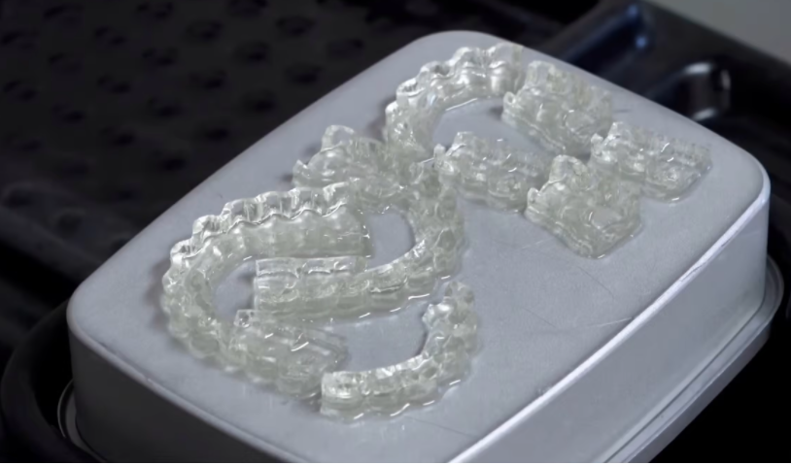
Fabrication process
Taking 3D Impression
Building Aligner model
Sent to conveyer belt
Data label imprint and RFID location
Notes:
The process begins with taking a 3D impression of the patient’s teeth using an intraoral scanner. Align technology uses the iTero scanner in capturing these digital impressions. The 3D impression is sent electronically to Align Street operations facilities. The digital impression is used in building a model using 3D printing for each of the stages in the patient’s treatment plan. The models are then placed on an automated assembly line. A unique data label is imprinted on each of the models and a location on the radio frequency emitting tray is assigned on each model to always identify its location. The models are sent down the conveyor system for other manufacturing processes.

Slide 5
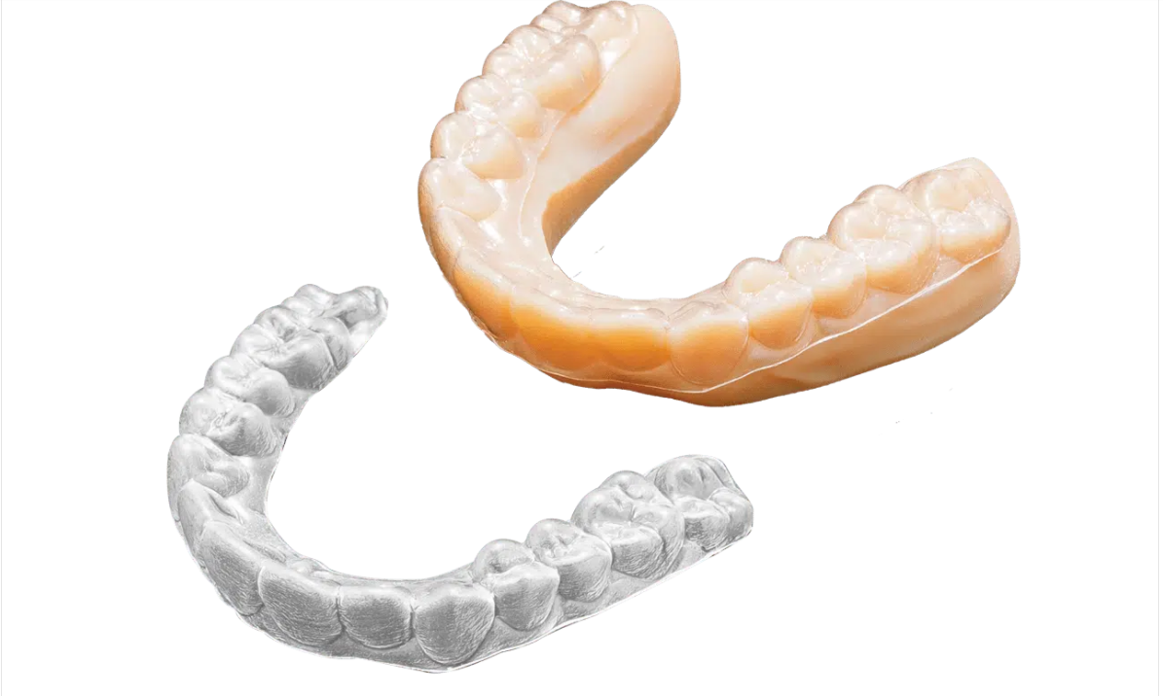
Forming and marking
Polymer is thermal formed
ID and Stage no. imprinted
ID and Stage no. imprinted
Notes:
Different steps also take place on the conveyer system including forming and marking. A polymer is thermal formed over the aligner models and then released to the trimming process. The machine reads the laser data label on the model and identifies the unique part. The patient ID and the stage number are added to the aligners for each patient. The Invisalign logo is also added to the aligner.

Slide 6
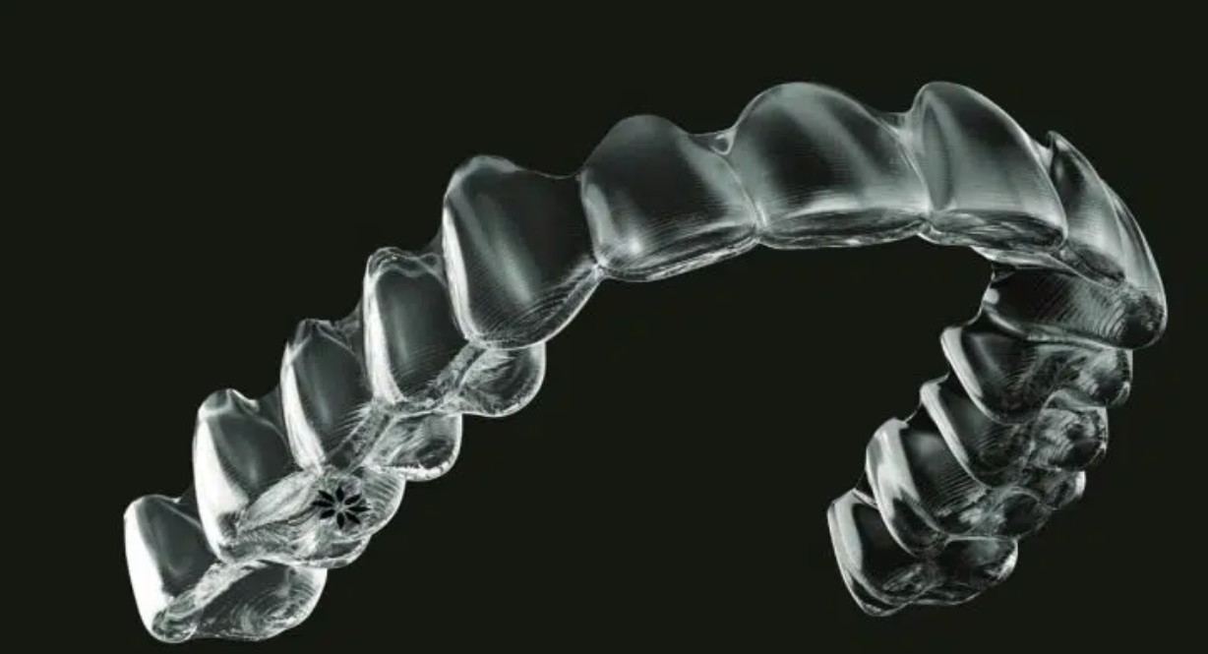
Trimming and polishing
Access the virtual data
Data is digitized into CNC
Gingival cuts on the aligners.
Notes:
The trim operation uses industrial trim machines. The trimming process relies on uses the label on each model to access the virtual data approved by the client on their treatment plan. The data is digitized into a computer numerical control path CNC which is used to make the gingival cuts on the aligners. The polishing process is done through an automated mask finishing process before the aligners are packaged.

Slide 7
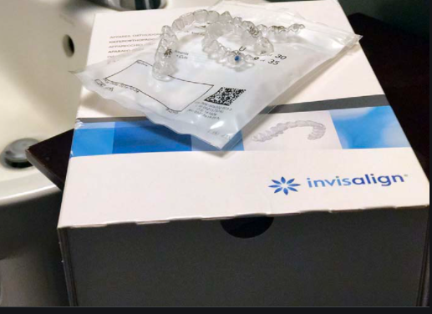
Packaging
Radio frequency pocket assigned
Sent to carousel system
Sequencing
Sequencing verification
Aligners are put in sealed bags
Aligners and attachment data packed in boxes
Notes:
The packaging operation is an automated process meant to eliminate possible human error as well as ensuring that the customers receive their aligners in the right sequence. The automated packaging machine receives aligners with different patient IDs and sorts them using the patient ID on each aligner. The machine grabs the aligner from the conveyer belt, reading the ID on the aligner, and assigns them to a radio frequency pocket. Each pocket is sent to the packaging carousel system. The carousel system has different stations based on different patient IDs to which the aligners are pulled based on the IDs. The aligners are placed in the right order of treatment sequence using a machine that also re-verifies the order. The automated machines produce the required boxes and assemble them. The machine identifies the groups of aligners coming in and puts them in a sealed bag before putting them into the assembled boxes. The machine also prints any required attachment data and puts it in the box alongside the aligners. A tamper-proof seal is applied to the box and the package is ready to ship to the customer.

Slide 8
Work cited
White, J., (2021) smiles by white orthodontics. [Online] smiles by white orthodontics. Available at: <https://www.Smilesbywhite.Com/patient-information/news/how-are-invisalign-braces-made/.

